Slide 1
Evolution of the Accessibility Ecosystem
Jenny Lay-Flurrie

Slide 2
Our History…

Slide 3

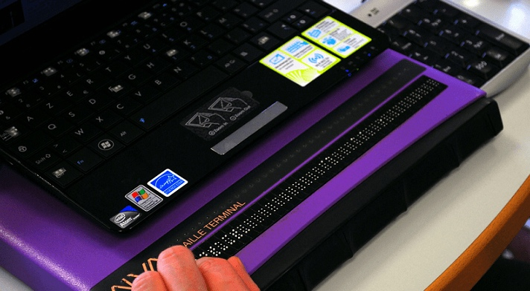
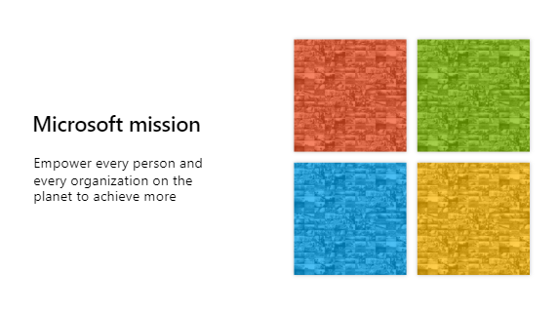
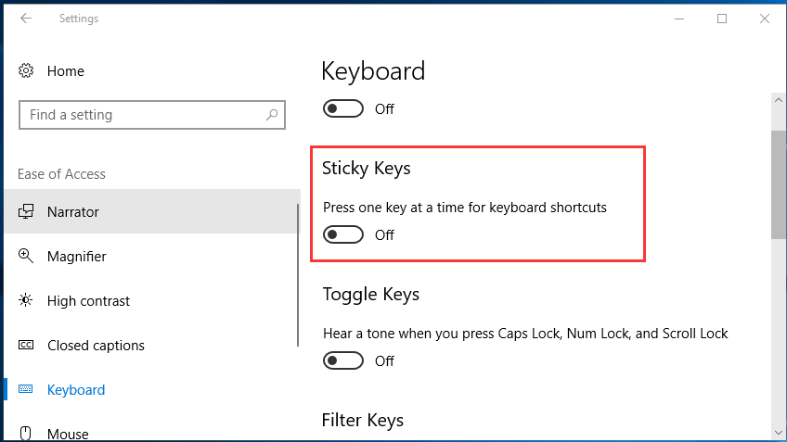
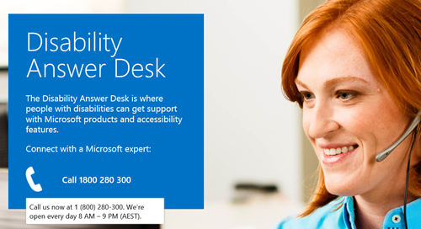
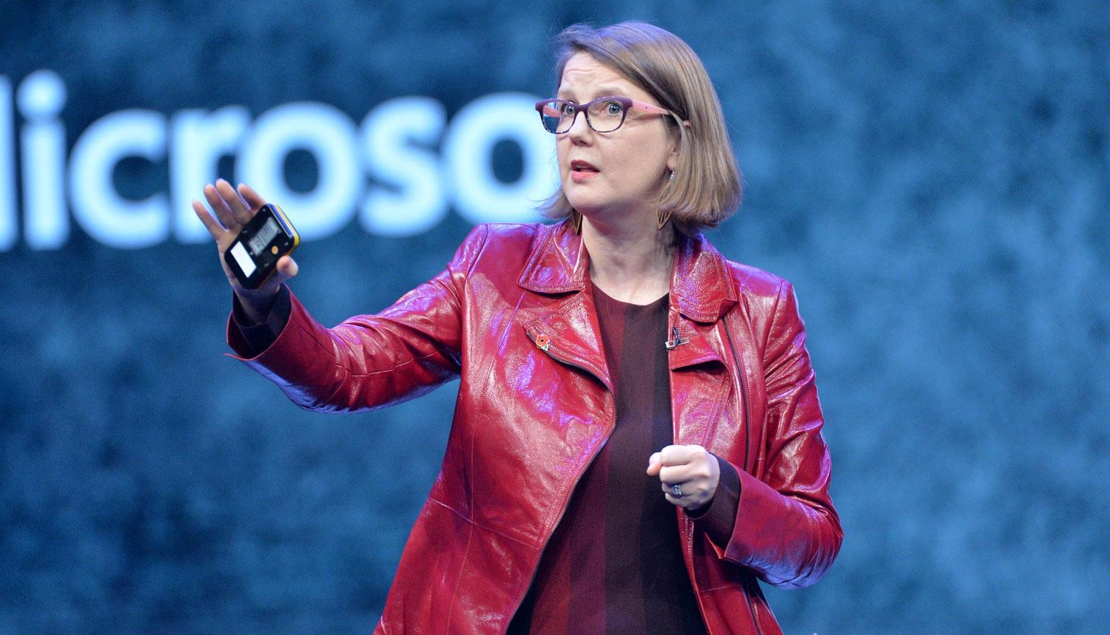
Our journey at Microsoft
Disability
Answer Desk
Accessibility Ecosystem
Sticky keys
1990s
1994
2000
2012
2015
2016
Employee disability groups
Screen reader
New company mission

Slide 4
Accessibility is a responsibility
1+ billion people with disabilities worldwide
Permanent
Temporary
Situational
(one arm)
(arm injury)
(new parent)
COVID has disproportionately affected people with disabilities
Long Covid (UK) 550K+
Mental Health (US) screening ~+800% 2020
People with disabilities paid 87 cents on the dollar compared to workers without disabilities
The poverty rate for people with disabilities - 26 percent
Hiring disabled talent, can increase talent pool 10+ million people in US alone

Slide 5
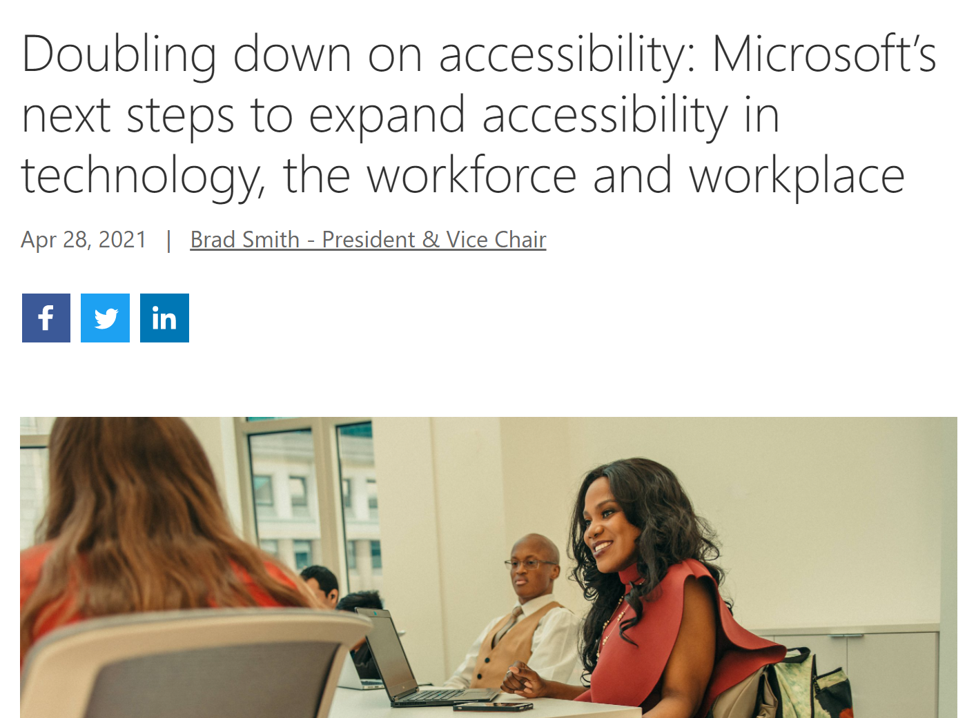
Bridging the Disability Divide
A new technology-led five-year commitment to create and open doors to bigger opportunities for people with disabilities.
Focus areas:
Technology
Talent Development
Employee Experience
Policy
Partnership
Learn more: aka.ms/accessibilitycommitment

Slide 6
How do we do it?

Slide 7
Org Structure
Engineering
(Products)
Product
telemetry
Hub and Spoke Model
Support
Marketing
Support
Marketing
Represent the company’s accessibility approach internally and externally
Facilitate and support game-changing innovations
Provide accessibility training and resources
Create scalable pipelines of talent
Manage and grow NGO relationships
Provide customer support for accessibility questions and use of assistive technology
Accessibility
Research
Sales
Supply
Chain
Sales
Procurement
Commerce

Slide 8
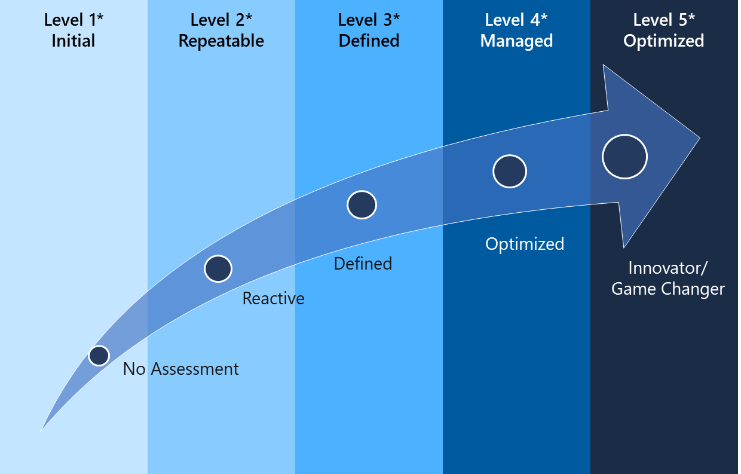
Manage accessibility like a business
Learn More: aka.ms/AccessibilityMaturityModel
Systematically measure progress and targets
Maturity models
Carnegie Mellon
Level Access
Microsoft Accessibility
Leadership Team
Microsoft Accessibility Evolution Model (AEM)
The Carnegie Mellon Capability Model and the Level Access Digital Accessibility Maturity Model

Slide 9
Changing hearts and minds

Slide 10
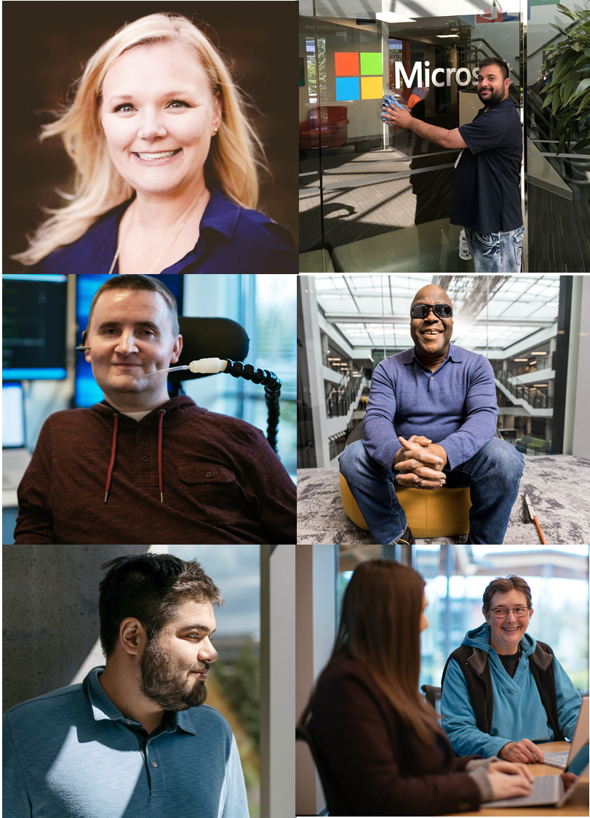
Inclusive Hiring
Disability is a strength, and our Inclusive Hiring programs include our Neurodiversity Hiring Program, Supported Employment, and broad disability hiring across the company.
Neurodiversity Hiring Program:
Recruiting, onboarding, and retention of neurodiverse candidates.
Supported Employment:
Supporting people with intellectual developmental disabilities via Real Estate & Facilities vendor ecosystem.
Broad Disability Hiring:
Foundational structures that support hiring people from all disability segments into FTE roles across Microsoft.
Learn More
aka.ms/InclusiveHiring

Slide 11
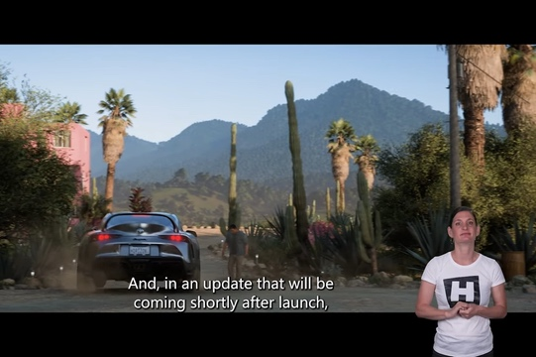
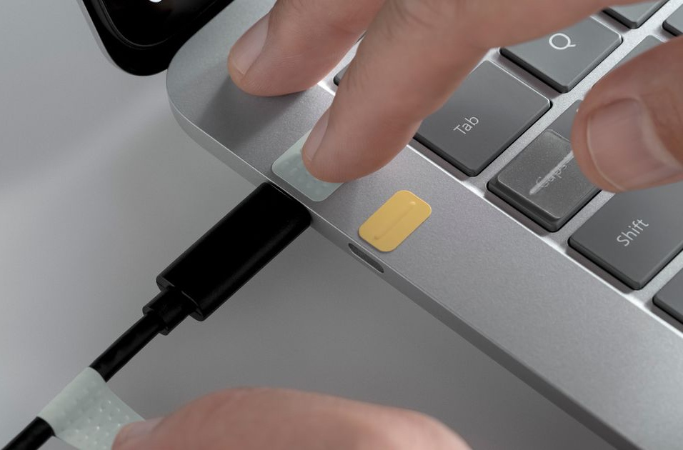
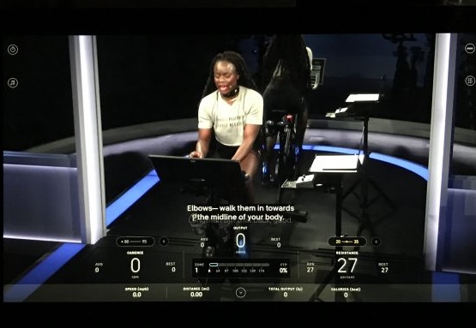
Innovation
Inclusive Gaming
Surface Adaptive Kit
Cognitive Services

Slide 12
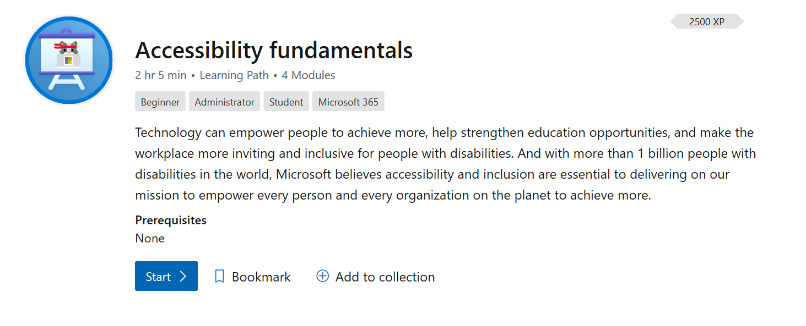
Training: Accessibility in Action Badge
160k!
Internal: aka.ms/AccLibrary External: aka.ms/AccessibilityFundamentals

Slide 13
Lessons Learned

Slide 14
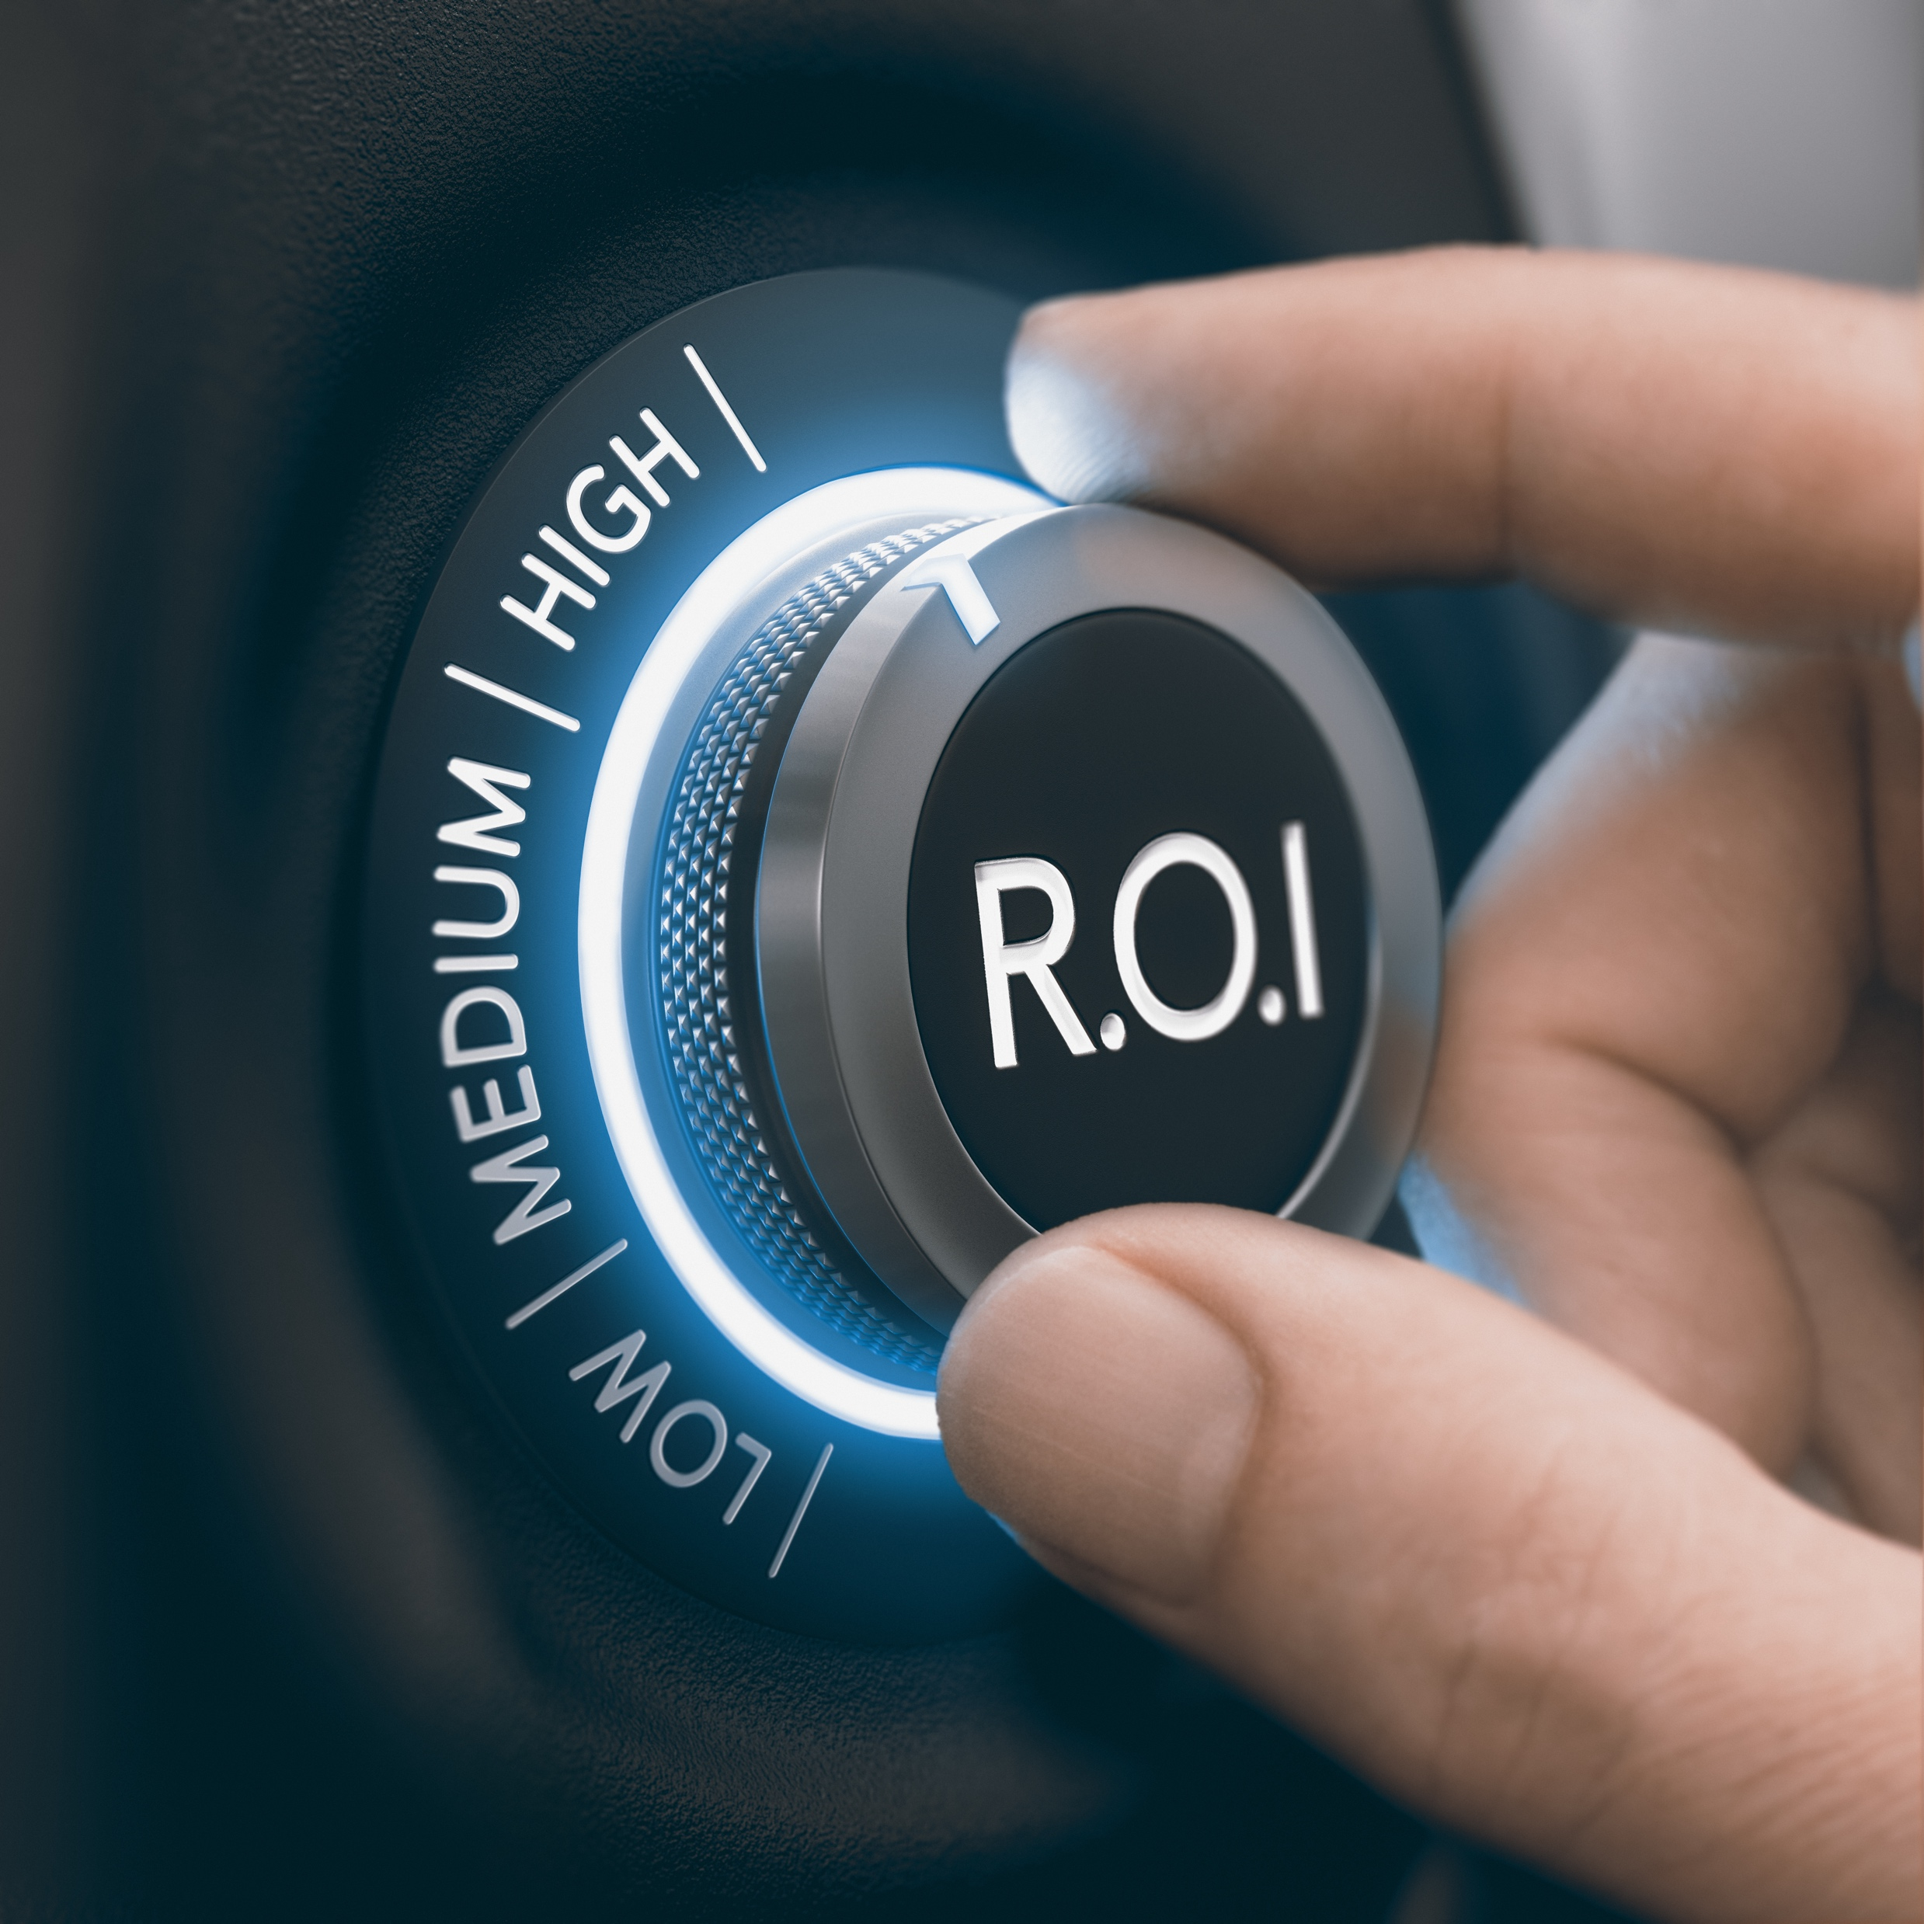
Avoid the ROI trap
1

Slide 15

Marathon… not a sprint
2

Slide 16

Advocacy fatigue is real
3

Slide 17

Celebrate then accelerate
4

Slide 18

Better together
5

Slide 19
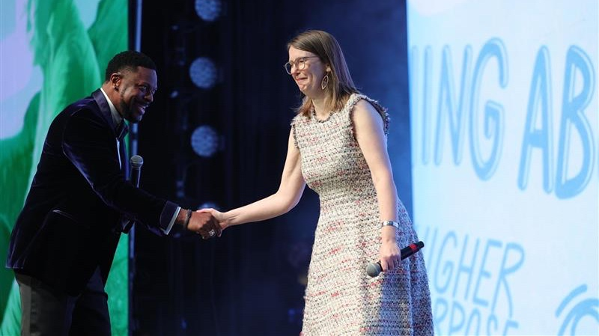
Imposter Syndrome

Slide 20

Questions?
Contact us at any time!
Jenny Lay-Flurrie (jennylf)
@jennylayfluffy
Disability Answer Desk
aka.ms/DisabilityAnswerDesk
Enterprise Disability Answer Desk
aka.ms/EnterpriseDisabilityAnswerDesk
Learn More:
Microsoft.com/Accessibility

Slide 21
End Card

